Slide 1
Defuzzification
Soft Computing
R5

Slide 2
DEFUZZIFICATION TO CRISP SETS
For fuzzy set A∼, define a lambda-cut set, A_{λ}, where 0 ≤ λ ≤ 1.
The set A_{λ} is a crisp set called the lambda (λ)-cut (or alpha-cut) set of the fuzzy set A∼
Any particular fuzzy set A∼can be transformed into an infinite number of λ-cut sets, because there are an infinite number of values λ on the interval [0, 1].

Slide 3
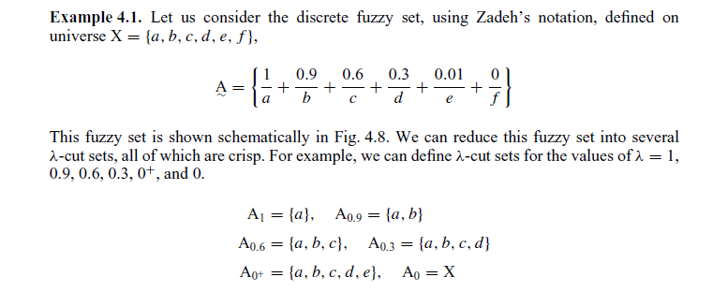
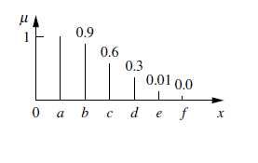

Slide 4
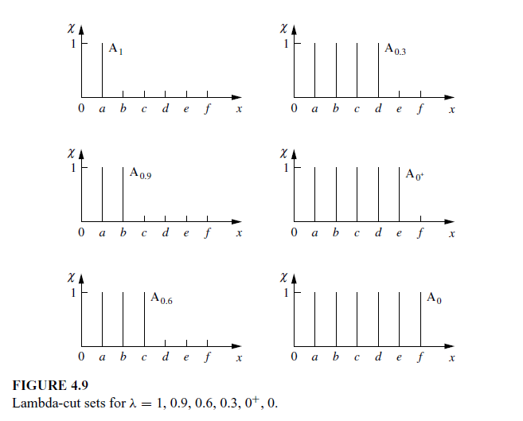

Slide 5
The quantity λ = 0⁺ is defined as a small ‘‘ε’’ value >0, i.e., a value just greater than zero.
By definition, λ = 0 produces the universe X, since all elements in the universe have at least a 0 membership value in any set on the universe.

Slide 6
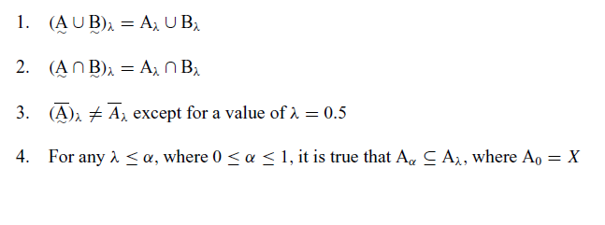
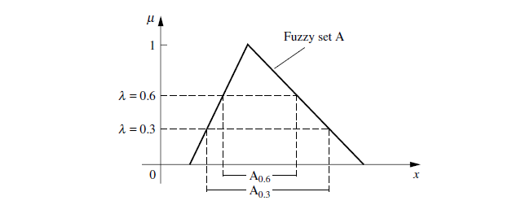
Properties of λ-cut sets

Slide 7
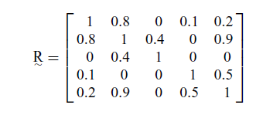
λ-CUTS FOR FUZZY RELATIONS

Slide 8
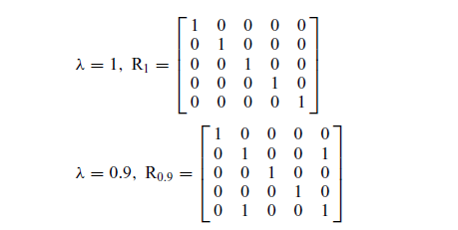

Slide 9
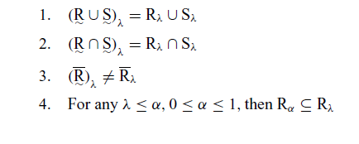
λ-cuts on fuzzy relations obey certain properties

Slide 10
DEFUZZIFICATION TO SCALARS
Defuzzification is the conversion of a fuzzy quantity to a precise quantity, just as fuzzification is the conversion of a precise quantity to a fuzzy quantity.
The output of a fuzzy process can be the logical union of two or more fuzzy membership functions defined on the universe of discourse of the output variable.

Slide 11
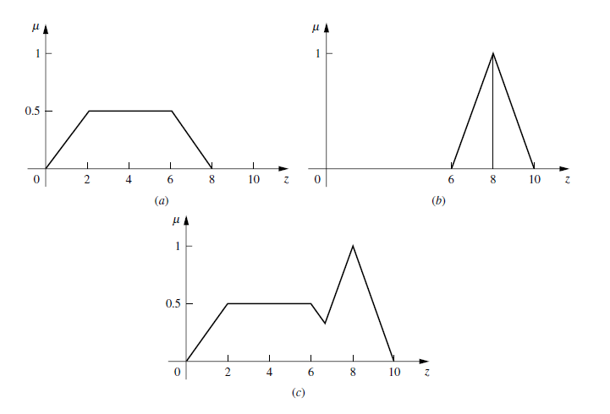

Slide 12
Max membership principle
Centroid method
Weighted average method:
Mean max membership
Center of sums
Center of largest area
First (or last) of maxima:

Slide 13
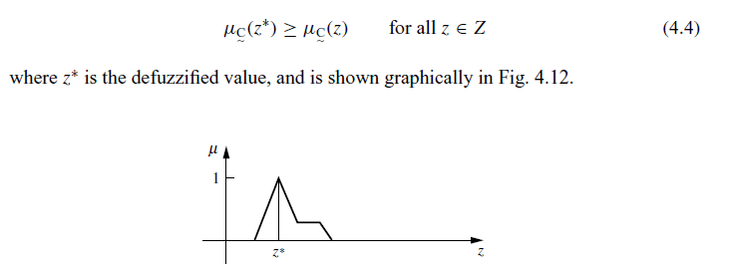
Max membership principle:Also known as the height method, this scheme is limited to peaked output functions.

Slide 14
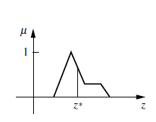
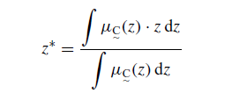
Centroid method: This procedure (also called center of area, center of gravity) is the most prevalent and physically appealing of all the defuzzification methods [Sugeno,1985; Lee, 1990];
it is given by the algebraic expression

Slide 15

Weighted average method: The weighted average method is the most frequently used in fuzzy applications since it is one of the more computationally efficient methods.
it is usually restricted to symmetrical output membership functions.
It is given by the algebraic expression

Slide 16
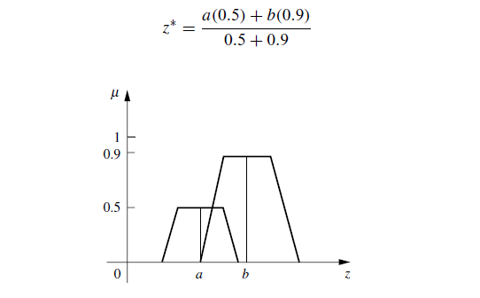

Slide 17
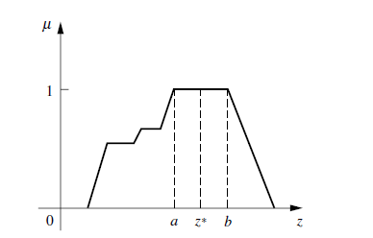

Mean max membership: This method (also called middle-of-maxima) is closely related to the first method, except that the locations of the maximum membership can be nonunique (i.e., the maximum membership can be a plateau rather than a single point).
This method is given by the expression

Slide 18
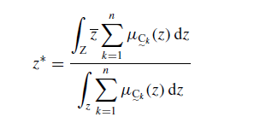
Center of sums: This is faster than many defuzzification methods that are presently in use, and the method is not restricted to symmetric membership functions.
This process involves the algebraic sum of individual output fuzzy sets, instead of their union.
Two drawbacks to this method are that the intersecting areas are added twice, and the method also involves finding the centroids of the individual membership functions

Slide 19
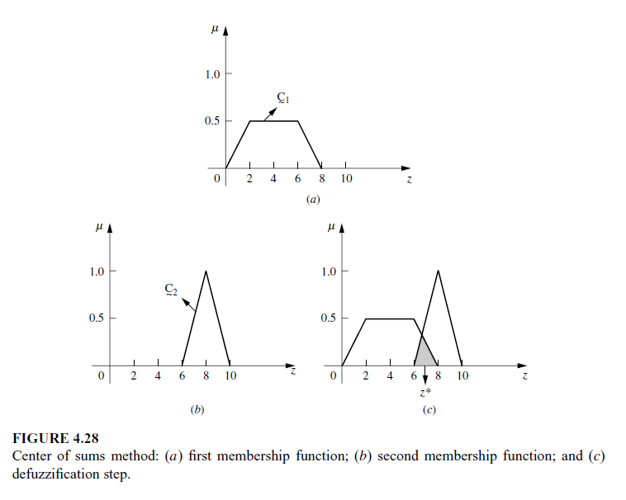

Slide 20
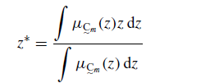
Center of largest area: If the output fuzzy set has at least two convex sub regions, thenthe center of gravity (i.e., z∗ is calculated using the centroid method, )of the convex fuzzy subregion with the largest area is used to obtain the defuzzified value.

Slide 21
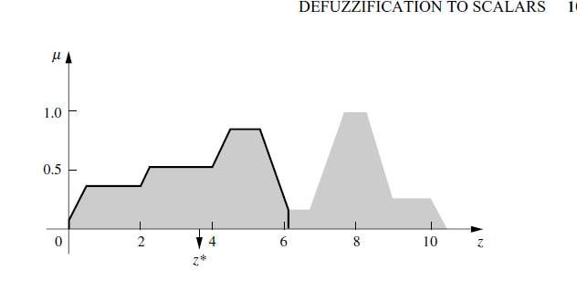

Slide 22

First (or last) of maxima: This method uses the overall output or union of all individual output fuzzy sets to determine the smallest value of the domain with maximized membership degree in C_{∼k}. The equations for z∗ are as follows.

Slide 23
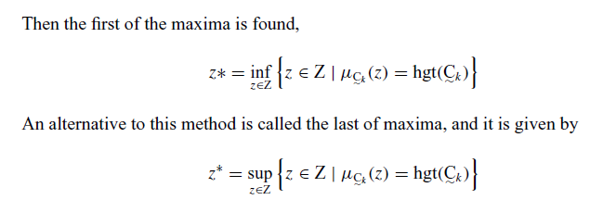
supremum (sup) is the least upper bound
and the infimum (inf) is the greatest lower bound.

Slide 24
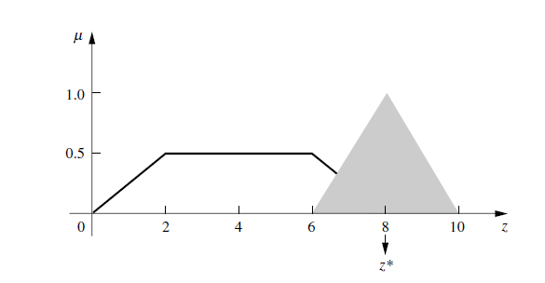

Slide 25
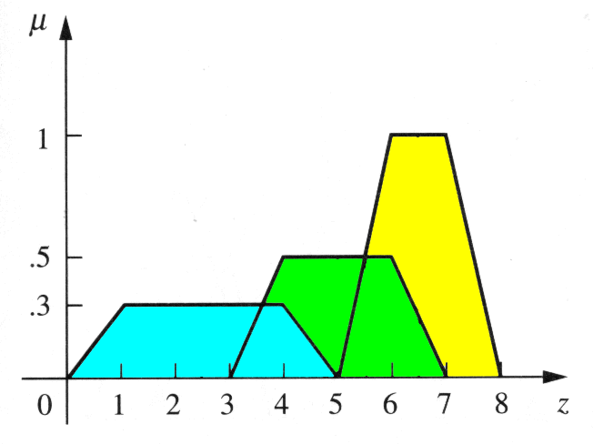
Example

Slide 26
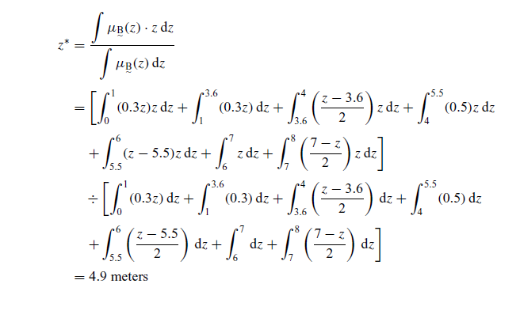
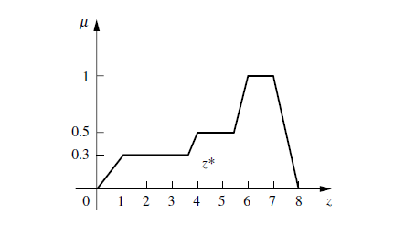
Accoding to centroid method

Slide 27

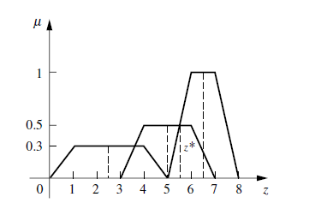
According to weighted average method

Slide 28
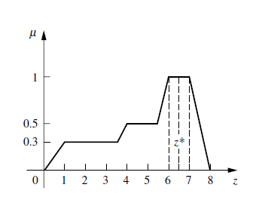
According to mean- max

Slide 29
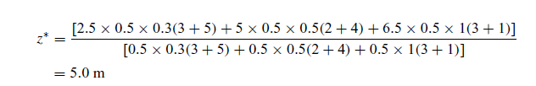
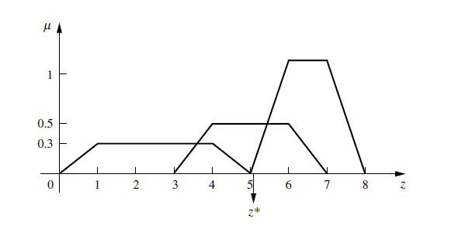
According to centre of sums

Slide 30
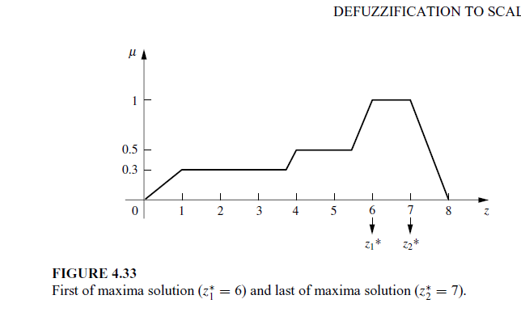
According to first of maxima and last of maxima

Slide 31
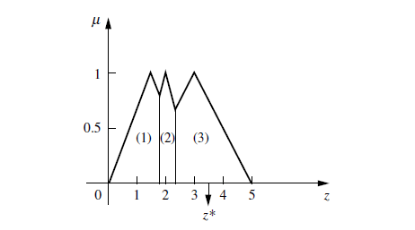

According to centre of largest Area

